Slide 1

Working of
Neural Networks

Slide 2
784 pixels
784 pixels
...
...
0
1
2
9
0
1
2
9
...
Linear Model
Deep Neural Network

Slide 3
Hidden Layers
Input
Output
Number of weights

Slide 4
Hidden Layer
Input
Output
2 * 1
2 * 3

Slide 5
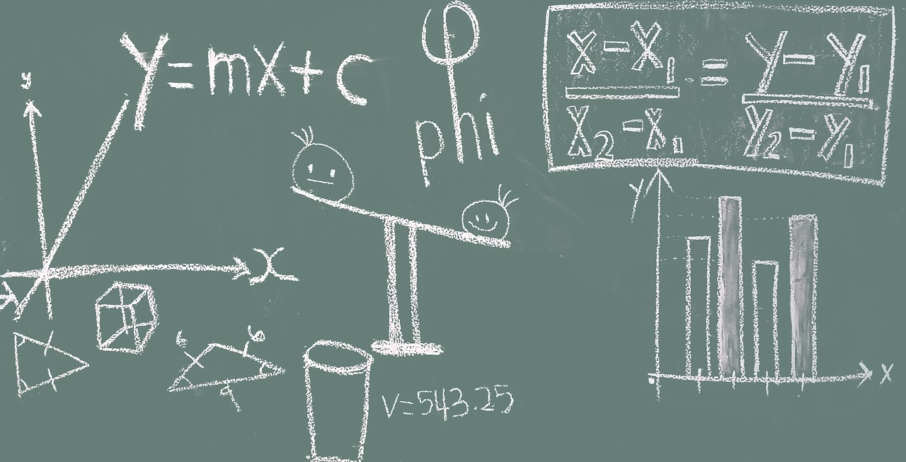
Math of Neural Networks

Slide 6
Requirement Data
x₁ | x₂ | y
1 | 2 | 3
Let’s understand how Model will use input features (x₁, x₂) and learn to predict y

Slide 7
Hidden Layer
Input
Output
1
2
Using a simple neural network with 1 hidden layer

Slide 8
Hidden Layer
W₁₁₁ =0.5
Input
W₁₁₂ =0.3
Output
1
2
Let’s calculate output for 1st Neuron in hidden layer

Slide 9
h₁₁ = xW + b
W₁₁₁ =0.5
Input
W₁₁₂ =0.3
Output
1
2

Slide 10
h₁₁ = 1 * 0.5 + 2 * 0.3 + 1
W₁₁₁ =0.5
Input
W₁₁₂ =0.3
Output
1
2
Initializing each weight with random numbers and bias with 1 (can be any number)

Slide 11
h₁₁
2.1
W₁₁₁ =0.5
Input
W₁₁₂ =0.3
Output
1
2

Slide 12
h₁₁
2.1
o₁₁ = sigmoid(h₁₁)
W₁₁₁ =0.5
Input
W₁₁₂ =0.3
Output
1
2
Apply activation (sigmoid) to Neuron’s output

Slide 13
h₁₁
2.1
o₁₁ = 0.89
W₁₁₁ =0.5
Input
W₁₁₂ =0.3
Output
1
2

Slide 14
h₁₁
2.1
o₁₁ = 0.89
W₁₁₁ = 0.5
Input
W₁₁₂ =0.3
h₂₁
Output
1
2
W₁₂₁ = 0.15
1.95
o₁₂ = 0.875
W₁₂₂ = 0.4
Repeat calculations for 2nd neuron...

Slide 15
h₁₁
2.1
o₁₁ = 0.89
W₁₁₁ = 0.5
Input
W₁₁₂ =0.3
h₂₁
Output
1
2
W₁₂₁ = 0.15
1.95
o₁₂ = 0.875
W₁₂₂ = 0.4
W₁₃₁ = 0.65
h₁₃
1.05
W₁₃₂ = -0.3
o₁₃ = 0.741
...and 3rd Neuron

Slide 16
h₁₁
2.1
o₁₁ = 0.89
W₁₁₁ = 0.5
W₁₁₂ =0.3
Output = 0.89* -0.23 + 0.875 * 0.83 + 0.741 * -0.56 + 1
Input
h₂₁
W₂₁₁ = -0.23
1
2
W₁₂₁ = 0.15
1.95
o₁₂ = 0.875
W₂₁₂ = 0.83
W₁₂₂ = 0.4
W₂₁₃ = -0.56
W₁₃₁ = 0.65
h₁₃
1.05
W₁₃₂ = -0.3
o₁₃ = 0.741
Initialize weights and bias for output layer and calculate output

Slide 17
h₁₁
2.1
o₁₁ = 0.89
W₁₁₁ = 0.5
Input
W₁₁₂ =0.3
h₂₁
W₂₁₁ = -0.23
Output
1
2
W₁₂₁ = 0.15
1.95
o₁₂ = 0.875
W₂₁₂ = 0.83
1.106
W₁₂₂ = 0.4
W₂₁₃ = -0.56
W₁₃₁ = 0.65
h₁₃
1.05
W₁₃₂ = -0.3
o₁₃ = 0.741
What’s next?

Slide 18
h₁₁
2.1
o₁₁ = 0.89
W₁₁₁ = 0.5
Input
W₁₁₂ =0.3
h₂₁
W₂₁₁ = -0.23
Output
1
2
Loss
W₁₂₁ = 0.15
1.95
o₁₂ = 0.875
W₂₁₂ = 0.83
1.106
(Prediction - Actual)²/2
W₁₂₂ = 0.4
W₂₁₃ = -0.56
W₁₃₁ = 0.65
h₁₃
1.05
W₁₃₂ = -0.3
o₁₃ = 0.741
Calculate Loss

Slide 19
h₁₁
2.1
o₁₁ = 0.89
W₁₁₁ = 0.5
Input
W₁₁₂ =0.3
h₂₁
W₂₁₁ = -0.23
Output
1
2
Loss
W₁₂₁ = 0.15
1.95
o₁₂ = 0.875
W₂₁₂ = 0.83
1.106
(1.106 - 3)²/2
= 1.793
W₁₂₂ = 0.4
W₂₁₃ = -0.56
W₁₃₁ = 0.65
h₁₃
1.05
W₁₃₂ = -0.3
o₁₃ = 0.741
Forward Propagation i.e starting with Input features, calculate Loss

Slide 20

How do we update weights?

Slide 21
h₁₁
2.1
o₁₁ = 0.89
W₁₁₁ = 0.5
Input
W₁₁₂ =0.3
h₂₁
W₂₁₁ = -0.23
Output
1
2
Loss
W₁₂₁ = 0.15
1.95
o₁₂ = 0.875
W₂₁₂ = 0.83
1.106
1.793
W₁₂₂ = 0.4
W₂₁₃ = -0.56
W₁₃₁ = 0.65
h₁₃
1.05
W₁₃₂ = -0.3
o₁₃ = 0.741
Minimizing Loss using Gradient Descent

Slide 22
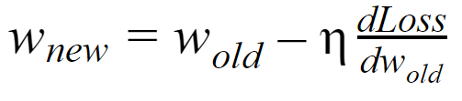
Gradient Descent
Calculate Gradient for Loss w.r.t each Weight and Bias in the Neural Network

Slide 23
h₁₁
2.1
o₁₁ = 0.89
W₁₁₁ = 0.5
Input
W₁₁₂ =0.3
h₂₁
W₂₁₁ = -0.23
Output
1
2
Loss
W₁₂₁ = 0.15
1.95
o₁₂ = 0.875
W₂₁₂ = 0.83
1.106
1.793
W₁₂₂ = 0.4
W₂₁₃ = -0.56
W₁₃₁ = 0.65
h₁₃
1.05
W₁₃₂ = -0.3
o₁₃ = 0.741
We start with Weights nearest to Output Layer e.g. W₂₁₁

Slide 24
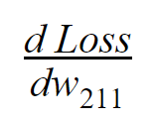
How is Loss related to w₂₁₁?

Slide 25
h₁₁
2.1
o₁₁ = 0.89
W₁₁₁ = 0.5
Input
W₁₁₂ =0.3
h₂₁
W₂₁₁ = -0.23
Output
1
2
Loss
W₁₂₁ = 0.15
1.95
o₁₂ = 0.875
W₂₁₂ = 0.83
1.106
1.793
W₁₂₂ = 0.4
W₂₁₃ = -0.56
W₁₃₁ = 0.65
h₁₃
1.05
W₁₃₂ = -0.3
o₁₃ = 0.741
Loss is dependent on Output, Output is dependent on W₂₁₁

Slide 26
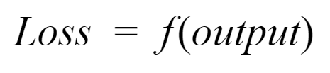

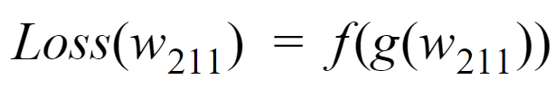

Slide 27

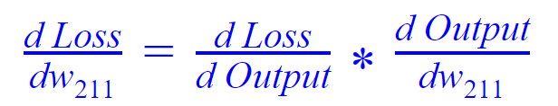
Let’s calculate each Gradient term individually

Slide 28
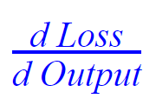

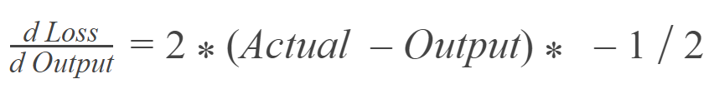
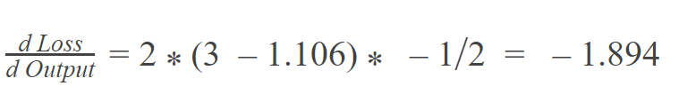

Slide 29
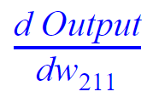

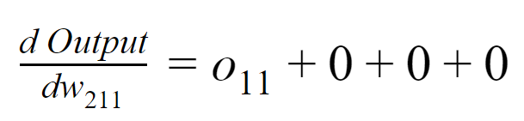
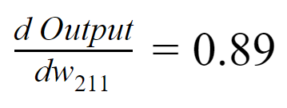

Slide 30
-1.894 * 0.89
= -1.686
What will be new value of w₂₁₁?

Slide 31
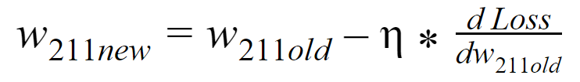
Learning rate (assume 0.01 here)
= -0.23 - 0.01 * -1.686
= -0.213

Slide 32


Calculate both in same way as W₂₁₁

Slide 33
h₁₁
2.1
o₁₁ = 0.89
W₁₁₁ = 0.5
Input
W₁₁₂ =0.3
h₂₁
W₂₁₁ = -0.23
Output
1
2
Loss
W₁₂₁ = 0.15
1.95
o₁₂ = 0.875
W₂₁₂ = 0.83
1.106
1.793
W₁₂₂ = 0.4
W₂₁₃ = -0.56
W₁₃₁ = 0.65
h₁₃
1.05
W₁₃₂ = -0.3
o₁₃ = 0.741
Updating weight for hidden layer e.g W₁₁₁

Slide 34
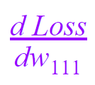
How is Loss related to w₁₁₁?

Slide 35
h₁₁
2.1
o₁₁ = 0.89
W₁₁₁ = 0.5
Input
W₁₁₂ =0.3
h₂₁
W₂₁₁ = -0.23
Output
1
2
Loss
W₁₂₁ = 0.15
1.95
o₁₂ = 0.875
W₂₁₂ = 0.83
1.106
1.793
W₁₂₂ = 0.4
W₂₁₃ = -0.56
W₁₃₁ = 0.65
h₁₃
1.05
W₁₃₂ = -0.3
o₁₃ = 0.741
W₁₁₁ → h₁₁ → o₁₁ → Output → Loss

Slide 36
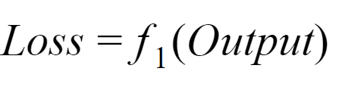
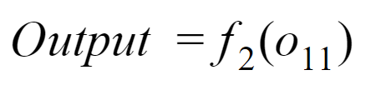
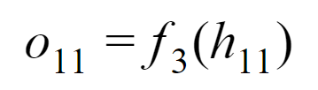


Slide 37
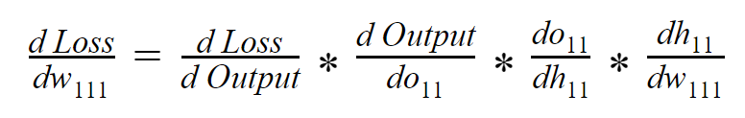
Using Chain Rule
Already calculated while calculating Gradient for Weights in Output Layer

Slide 38
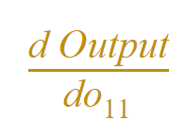

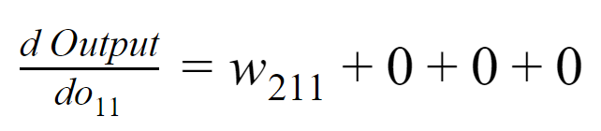
Gradient in Hidden Layer is dependent on Weights in Next Layers
-0.23

Slide 39
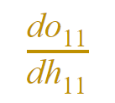
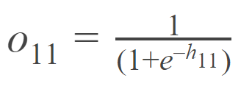
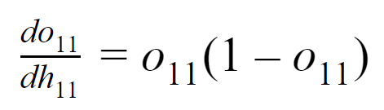
Activation (Sigmoid) function
NOTE!
Activation function should be Differentiable i.e it should be possible to calculate partial derivative of Activation function
0.89*(1-0.89)
=0.0979

Slide 40
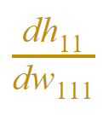
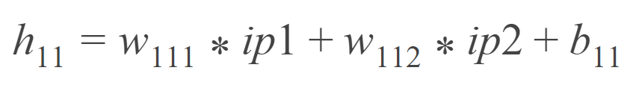
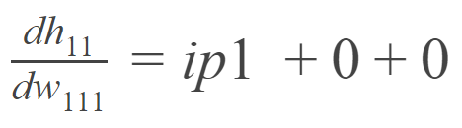
1

Slide 41
-1.894 * -0.23 * 0.0979 * 1
= 0.0426

Slide 42
New value of w₁₁₁
= 0.5 - 0.01 * 0.0426
= 0.499
Calculate Gradients and perform Descent for other Weights in Hidden layer

Slide 43
Backpropagation
Propagating Loss or Error to all the layers in the network, starting with Output Layer

